Slide 1
Module 2, Section 4: AWS Core Services - Databases
© 2018, Amazon Web Services, Inc. or its Affiliates. All rights reserved.
Notes:
Welcome to Module 2, Section 4 – AWS Core Services - Database.
1

Slide 2
What’s In This Module
Module 2, Section 4 – Core Services - Database
Part 1: Amazon Relational Database Service (Amazon RDS)
Part 2: Amazon DynamoDB
Part 3: Amazon Redshift
Part 4: Amazon Aurora
Notes:
The business world is constantly changing and evolving. By accurately recording, updating and tracking data on an efficient and regular basis, companies can leverage the immense potential from the insights obtained from their data. Database management systems are the crucial link for management of this data. Like other cloud services, cloud databases offer significant cost advantages over traditional database strategies.
In this module, we’ll review the Amazon Relational Database Service (or Amazon RDS), Amazon DynamoDB, Amazon Redshift and Amazon Aurora.
2

Slide 3
Module Objectives
Discuss key concepts related to database including.
Provide an overview of different database services in the cloud.
Highlight the difference between unmanaged and managed database solutions.
Understand the differences between Structured Query Language (SQL) and NoSQL databases.
Review the availability differences of alternative database solutions.
Notes:
In this module, you’ll discover key concepts related to database solutions including:
Understanding the different database services in the cloud.
Discovering the differences between unmanaged and managed database solutions.
Understanding the differences between Structured Query Language (or SQL) and NoSQL databases.
Comparing the availability differences of alternative database solutions.
The goal of this module is to help you understand the database resources that are available to power your solution. We will also review the different service features that are available, so you can begin to understand how different choices impact things like solution availability.

Slide 4
Part 1: Database Services: Amazon Relational Database Service (RDS)
Notes:
Welcome to an introduction to the database services available on Amazon Web Services. We begin with Amazon’s Relational Database Service (or RDS).
4

Slide 5

Amazon Database
Amazon Relational Database Service (RDS)
Notes:
Let’s start by taking a look at the differences between a managed and unmanaged service in the Amazon Relational Database Service (or RDS).
5

Slide 6




Unmanaged vs. Managed Services
Unmanaged:
Managed:
Scaling, fault tolerance, and availability are managed by you.
Scaling, fault tolerance, and availability are typically built in to the service.
Notes:
AWS solutions typically fall into one of two categories: unmanaged or managed.
Unmanaged services are typically provisioned in discrete portions as specified by you, requiring users to manage how the service responds to changes in load, errors, and situations where resources become unavailable. For instance, if you launch a web server on an Amazon Elastic Compute Cloud (or Amazon EC2) instance, that web server will not scale to handle increased traffic load or replace unhealthy instances with healthy ones, unless you specify it to use a scaling solution, such as AWS Automatic Scaling, because Amazon EC2 is an "unmanaged" solution. The benefit to using an unmanaged service is that you have more fine-tuned control over how your solution handles changes in load, errors, and situations where resources become unavailable.
Managed services require the user to configure them. For example, creating an Amazon Simple Storage Solution bucket and setting permissions for it. However, managed services typically require far less configuration. For example, if you have a static website that you're hosting in a cloud-based storage solution, such as Amazon S3, without a web server, those features (including scaling, fault-tolerance, and availability) would be automatically handled internally by Amazon S3, because it is a managed solution.
Now, let’s look at the challenges of running an unmanaged, standalone relational database. Then, we will see how the Amazon Relational Database Service addresses these challenges.
6

Slide 7
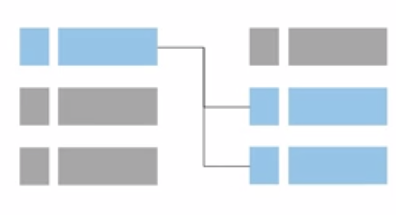

Challenges of Relational Databases
Server maintenance and energy footprint
Software installation and patches
Database backups and high availability
Limits on scalability
Data security
Operating System (OS) installation and patches
Notes:
When running your own relational database, you are responsible for several administrative tasks, such as server maintenance and energy footprint, software, installation and patching, database backups, and ensuring high availability, scalability planning, data security, and Operating System (OS) installation and patching. All of these tasks take resources away from other items on your to-do list and require expertise in several areas.
7

Slide 8
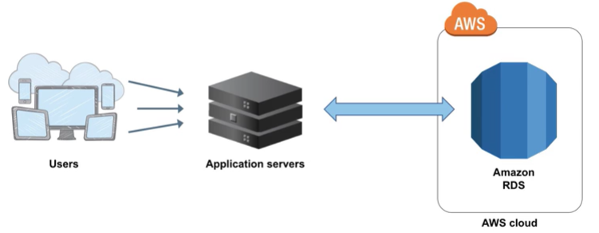
Amazon RDS
Managed service that sets up and operates a relational database in the cloud.
Notes:
Amazon RDS is a managed service that sets up and operates a relational database in the cloud.
To address the challenges of running an unmanaged, standalone relational database, AWS provides a service that sets up, operates, and scales the relational database without any ongoing administration. Amazon RDS provides cost-efficient and resizable capacity, while automating time-consuming administrative tasks.
Amazon RDS frees you to focus on your application, so you can give the applications the performance, high availability, security, and compatibility they need. With Amazon RDS, your primary focus is your data and optimizing your application.

Slide 9

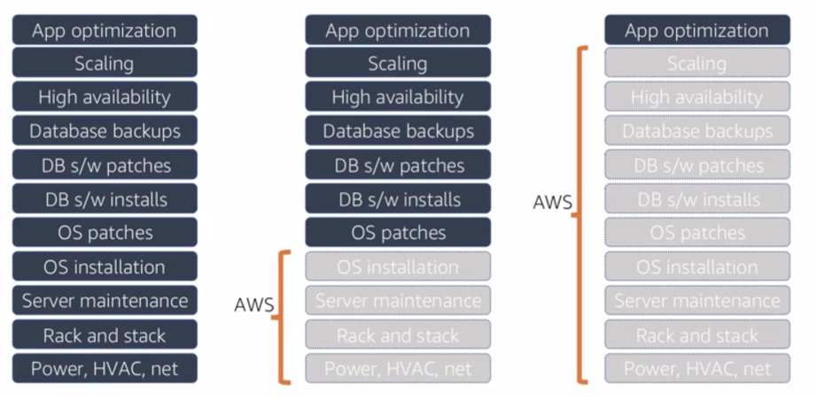

From On-Premises to Amazon RDS
Database On-premises Database in Amazon EC2 Database in Amazon RDS
or Amazon Aurora
Notes:
What do we mean by managed services? Let’s take a look.
When your database is on-premises, the database administrator is responsible for everything from app and query optimization to setting up the hardware, patching the hardware, and setting up networking, power and HVAC.
If you move to a database running on an Amazon EC2 instance, you no longer have to manage the underlying hardware or handle data center operations. However, you are still responsible for patching the operating system and handling all software and backup operations.
If you set up your database on Amazon RDS or Amazon Aurora, you free yourself from the administrative responsibilities. By moving to the cloud, you can automatically scale your database, enable high availability, manage backups and perform patching so that you can focus on what really matters most – optimizing your application.
9

Slide 10

Managed Services Responsibilities
You manage:
Application optimization
AWS Manages:
OS installation and patches
Database software install and patches
Database backups
High availability
Scaling
Power and rack & stack
Server maintenance
Amazon RDS
Notes:
With Amazon RDS, you manage your application optimization, while AWS manages operating system installation and patching, database software installation and patching, automatic backups and high availability.
Scaling resources, managing power and servers, and performing maintenance is also covered by AWS.
Offloading these operations to the managed Amazon RDS service reduces your operational workload and the costs associated with your relational database. Now, let's go through a brief overview of the service and a few potential use cases.
10

Slide 11
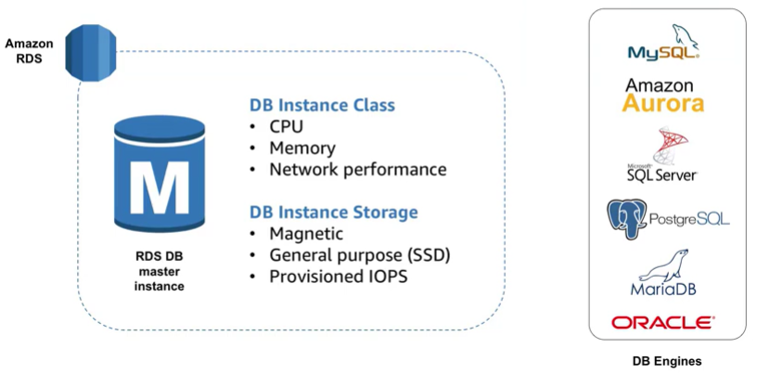
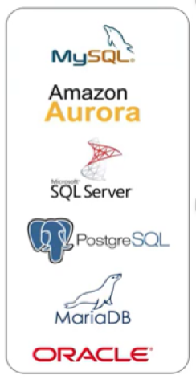
Amazon RDS DB Instances
Amazon RDS
DB Instance Class
CPU
Memory
Network Performance
DB Instance Storage
Magnetic
General Purpose (SSD)
Provisioned IOPS
M
RDS DB master
instance
DB Engines
Notes:
The basic building block of Amazon RDS is the database instance. A database instance is an isolated database environment that can contain multiple user-created databases and can be accessed by using the same tools and applications that you use with a standalone database instance. The resources found in a database instance are determined by its database instance class, and the type of storage is dictated by the type of disks.
Database instances and storage differ in performance characteristics and price, allowing you to tailor your performance and cost to the needs of your database. When you choose to create a database instance, you first have to specify which database engine to run. Amazon RDS currently supports six databases: MySQL, Amazon Aurora, Microsoft Sequel Server, PostgreSQL, MariaDB, and Oracle.

Slide 12
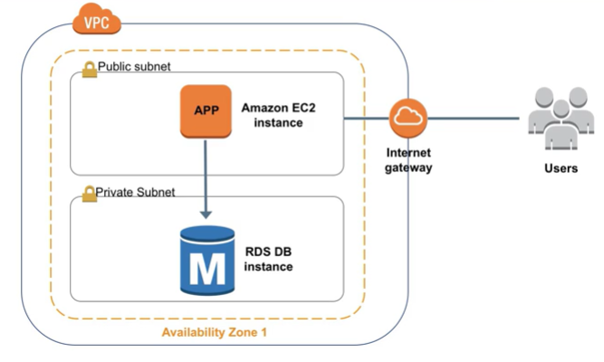
Amazon RDS In a Virtual Private Cloud
Notes:
You can run an instance using Amazon Virtual Private Cloud (Amazon VPC). When you use an Amazon VPC, you have control over your virtual networking environment.
You can select your own IP address range, create subnets, and configure routing and access control lists. The basic functionality of Amazon RDS is the same whether or not it is running in an Amazon VPC. Usually the database instance is isolated in a private subnet and is only made directly accessible to indicated application instances. Subnets in an Amazon VPC are associated with a single Availability Zone, so when you select the subnet, you're also choosing the Availability Zone or physical location for your database instance.

Slide 13
High Availability
High availability refers to systems that are durable and likely to operate continuously without failure for a long time. (technopedia.com)
Almost always means there are redundant components.
Sometimes measured in number of 9’s
How much downtime/year is “one nine” ?
How about “two nines” ?
Concerns both scheduled and unscheduled downtime

Slide 14
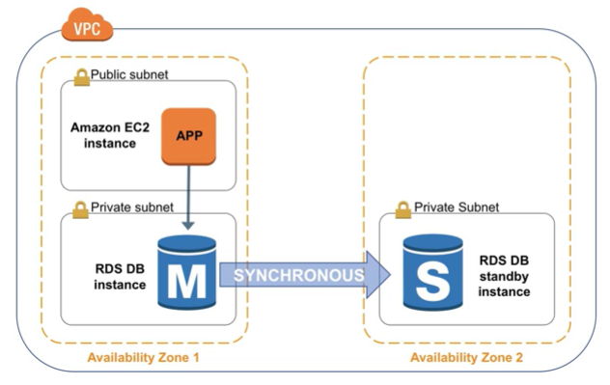
High Availability with Multiple Availability Zones
Notes:
One of the most powerful features of Amazon RDS is the ability to configure your database instance for high availability with a multi-AZ deployment. Once configured, Amazon RDS automatically generates a standby copy of the database instance in another Availability Zone within the same Amazon VPC. After seeding the database copy, transactions are synchronously replicated to the standby copy. Running a database instance with multiple Availability Zones can enhance availability during planned system maintenance and help protect your databases against database instance failure and Availability Zone disruption.

Slide 15
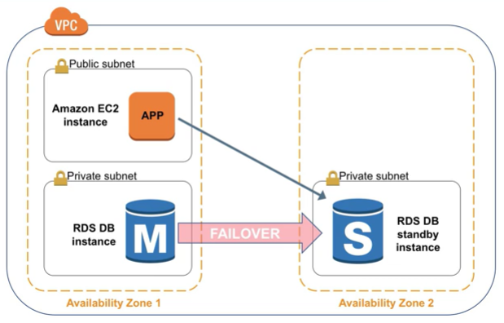
High Availability with Multiple Availability Zones
VPC
Public subnet
Amazon EC2
instance
App
Private subnet
Private subnet
RDS DB
instance
M
S
RDS DB
standby
instance
FAILOVER
Availability Zone 1
Availability Zone 2
Notes:
Therefore, if the master database instance fails, Amazon RDS automatically brings the standby database instance online as the new master. Because of the synchronous replication, there should be no data loss. Because your applications reference the database by name using RDS DNS endpoint, you don't need to change anything in your application code to use the standby copy for failover.

Slide 16
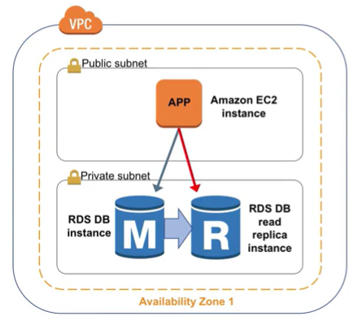
Amazon RDS Read Replicas
Features
Asynchronous replication
Promote to master if needed
Functionality
Read-heavy database workloads
Offload read queries
VPC
Public subnet
Amazon EC2
instance
App
Private subnet
RDS DB
read
replica instance
RDS DB instance
M
R
Availability Zone 1
Notes:
Amazon RDS also supports the creation of read replicas for MySQL, MariaDB, PostgreSQL, and Amazon Aurora. Updates made to the source database instance are asynchronously copied to the read replica instance. You can reduce the load on your source database instance by routing read queries from your applications to the read replica. Using read replicas, you can also scale out beyond the capacity constraints of a single database instance for read-heavy database workloads. Read replicas can also be promoted to become the master database instance, but due to the asynchronous replication, this requires manual action.
Read replicas can be created in a different region than the master database. This feature can help satisfy disaster recovery requirements or cut down on latency by directing reads to a read replica closer to the user.

Slide 17
Use Cases
Web and mobile applications | High throughput Massive storage scalability High availability
E-commerce applications | Low-cost database Data security Fully managed solution
Mobile and online games | Rapidly grow capacity Automatic scaling Database monitoring
Notes:
Amazon RDS is ideal for web and mobile applications that need a database with high throughput, massive storage scalability, and high availability. Since Amazon RDS does not have any licensing constraints, it perfectly fits the variable usage pattern of these applications. When it comes to small and large e-commerce businesses, Amazon RDS provides a flexible, secured, and low-cost database solution for online sales and retailing. Mobile and online games require a database platform with high throughput and availability. Amazon RDS manages the database infrastructure, so game developers do not have to worry about provisioning, scaling, or monitoring database servers.

Slide 18
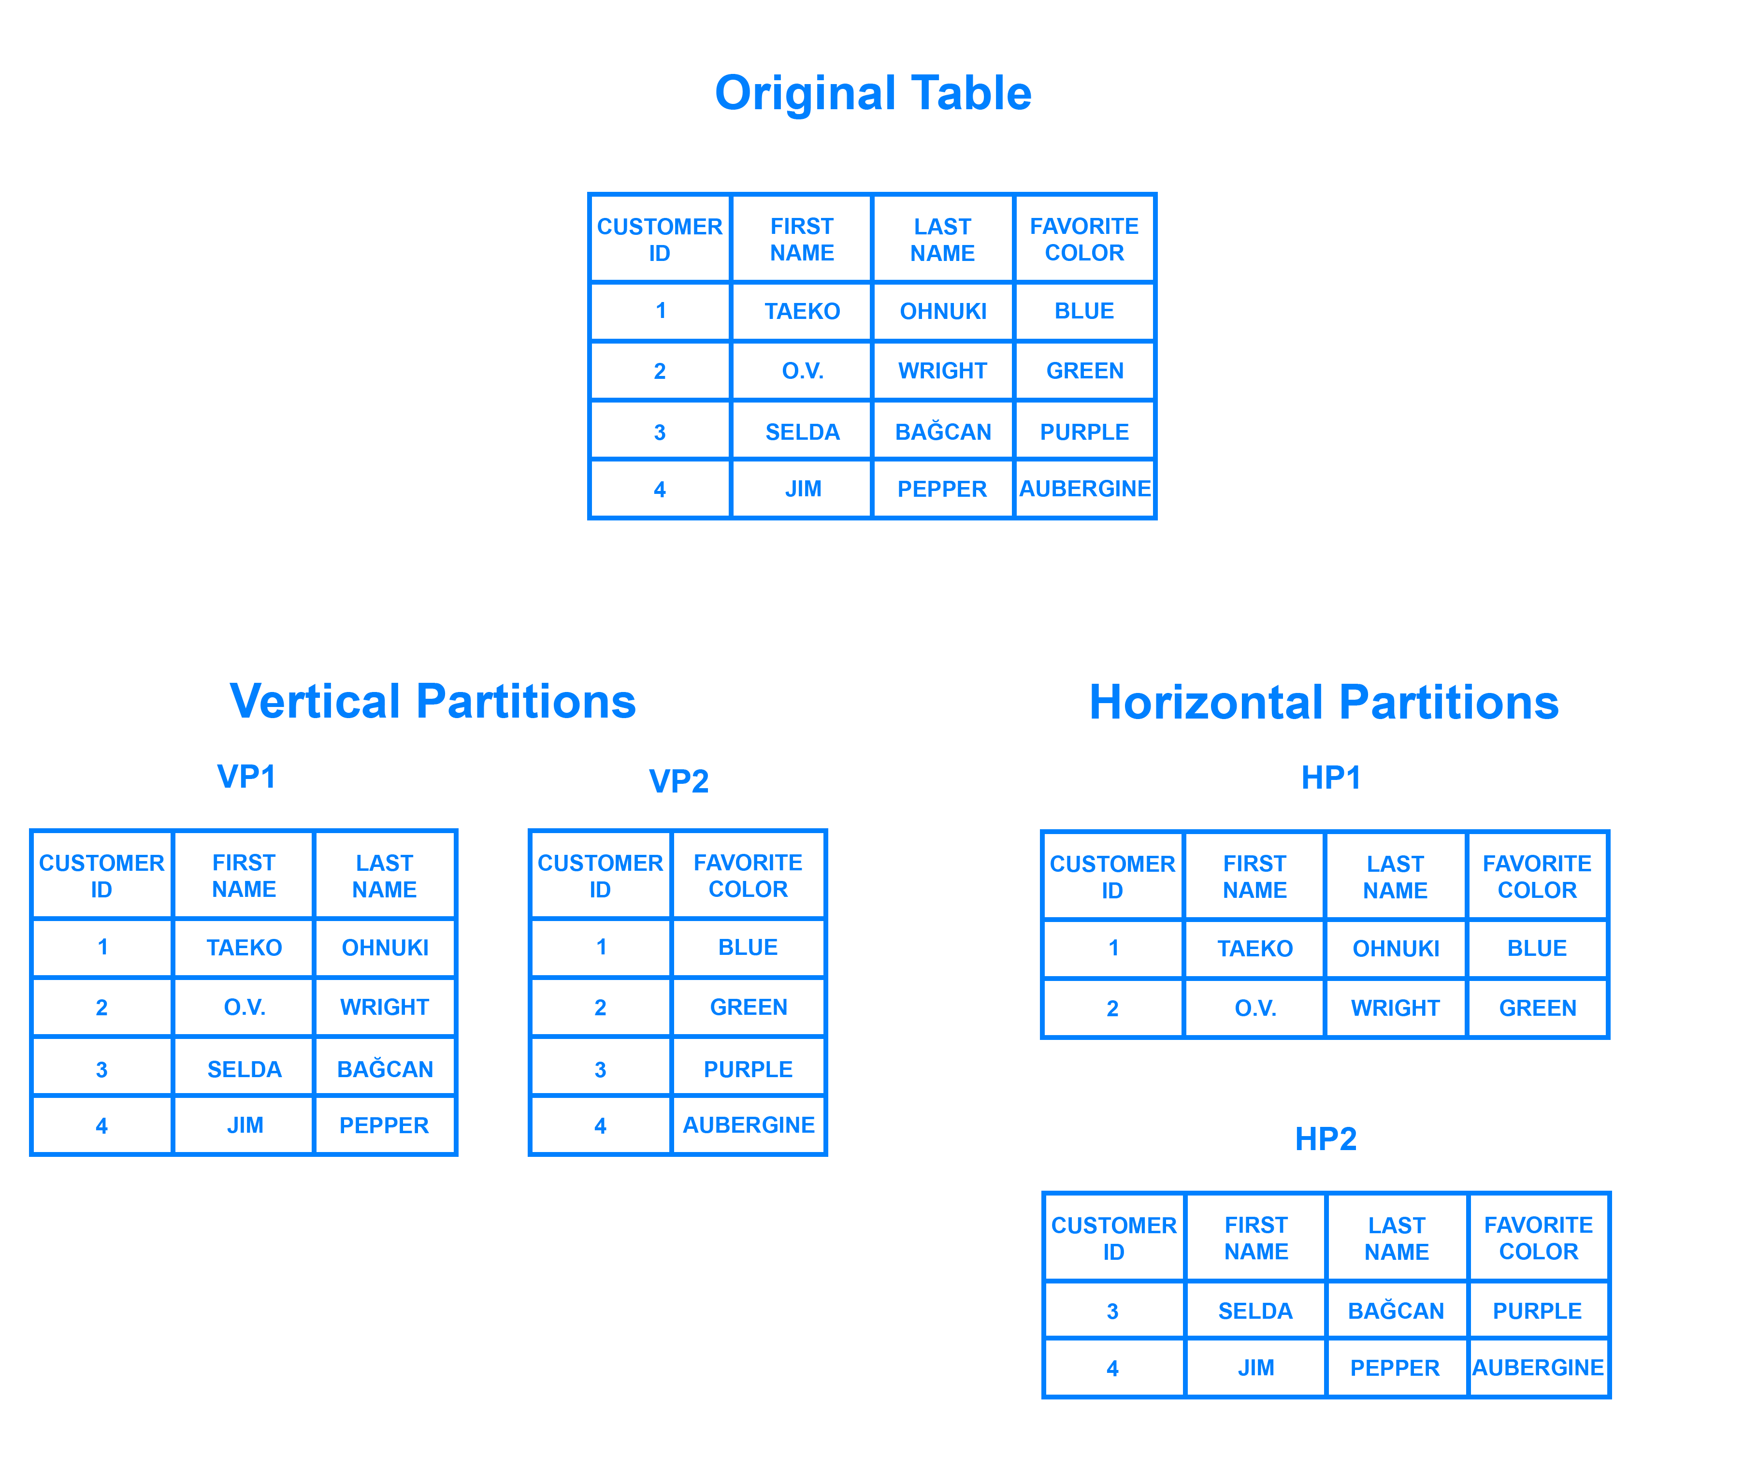
Relational Database Sharding https://www.digitalocean.com/community/tutorials/understanding-database-sharding
Notes:
18

Slide 19
When to Use Amazon RDS
Use Amazon RDS when your app requires:
Do not use Amazon RDS when your app requires:
Complex transactions or complex queries
A medium to high query/write rate – up to 30K IOPS (15K reads + 15K writes)
No more than a single worker node/shard
High durability
Massive read/write rates (e.g., 150K write/second)
Sharding due to high data size or throughput demands
Simple GET/PUT requests and queries that a NoSQL database can handle
Relational Database Management System (RDBMS) customization
Notes:
Use Amazon RDS when your app requires:
Complex transactions or complex queries
A medium to high query/write rate - up to 30K IOPS (15K reads + 15K writes)
No more than a single worker node/shard
High durability
Do not use Amazon RDS when your app requires:
Massive read/write rates (for example 150,000 writes per second)
Sharding due to high data size or throughput demands
Simple GET/PUT requests and queries that a NoSQL database can handle
Or, relational Database Management System (or RDBMS) customization
For circumstances where you should not use Amazon RDS, consider either using a NoSQL database solution, such as DynamoDB or running your relational database engine on Amazon EC2 instances instead of Amazon RDS, which will provide you with more options for customizing your database.
19

Slide 20
Amazon RDS: Clock-Hour Billing and Database Characteristics
Clock-Hour Billing:
Resources incur charges when running
Database Characteristics:
Physical capacity of database:
Engine
Size
Memory class
Notes:
When you begin to estimate the cost of Amazon RDS, you need to consider the clock hours of service time, which are resources that incur charges when they are running. For example, from the time you launch a database instance until you terminate the instance.
Database characteristics should also be considered. The physical capacity of the database you choose will affect how much you are charged. Database characteristics vary depending on the database engine, size, and memory class.
20

Slide 21
Amazon RDS: DB Purchase Type and Multiple DB Instances
DB Purchase Type:
On-demand database instances
Compute capacity by the hour
Reserved database instances
Low, one time, up-front payment for database instances reserved with 1 or 3 year term
Number of DB Instances:
Provision multiple DB instances to handle peak loads
Notes:
Consider the database purchase type. When you use on-demand database Instances, you pay for compute capacity for each hour your database instance runs, with no required minimum commitments. With Reserved Database Instances, you can make a low, one-time, up-front payment for each database Instance you wish to reserve for a 1-year or 3-year term.
Also consider the number of database instances. With Amazon RDS, you can provision multiple database instances to handle peak loads.
21

Slide 22
Amazon RDS: Storage
Provisioned Storage:
No charge
Backup storage of up to 100% of database storage for active database
Charge (GB/month)
Backup storage for terminated DB instances
Additional Storage:
Charge (GB/month)
Backup storage in addition to provisioned storage
Notes:
Consider provisioned storage. There is no additional charge for backup storage of up to 100% of your provisioned database storage for an active database instance. After the database instance is terminated, backup storage is billed per gigabyte per month.
Also consider the amount of backup storage in addition to the provisioned storage amount, which is billed per gigabyte, per month.
22

Slide 23
Amazon RDS: Deployment Type and Data Transfer
Requests:
The number of input and output request made to the database
Deployment Type - Storage and input/output (I/O) charges vary depending:
Single Availability Zones
Multiple Availability Zones
Data Transfer:
No charge for Inbound data transfer
Tiered charges for outbound data transfer
Notes:
You’ll want to consider the number of input and output requests made to the database.
Consider the deployment type, as you can deploy your DB instance to a single Availability Zone (which is analogous to a stand-alone data center) or multiple Availability Zones (which is analogous to secondary data center for enhanced availability and durability). Storage and input/output charges vary, depending on the number of Availability Zones you deploy to.
Finally, consider data transfer. Inbound data transfer is free, and outbound data transfer costs are tiered.
Depending on the needs for your application, it’s possible to optimize your costs for Amazon RDS database instances by purchasing reserved Amazon RDS database instances. To purchase Reserved Instances, you make a low, one-time payment for each instance you want to reserve and in turn receive a significant discount on the hourly usage charge for that instance.
23

Slide 24
In Review
Set up, operate, and scale relational databases in the cloud.
Features include:
Managed service
Accessible via the console, AWS RDS CLI, or simple API calls
Scalable (compute and storage)
Automated redundancy and backup available
Supported database engines:
Amazon Aurora, PostgreSQL, MySQL, MariaDB, ORACLE, Microsoft SQL Server
Notes:
Amazon RDS is a web service that makes it easy to set up, operate, and scale a relational database in the cloud. It provides cost-efficient and resizable capacity while managing time-consuming database administration tasks, so you can focus on your applications and business.
Features include being a managed service, accessible via the console, AWS RDS CLI, or simple API calls.
It’s scalable for compute and storage with automated redundancy and backup available.
Supported database engines include Amazon Aurora, PostgreSQL, MySQL, MariaDB, ORACLE, and Microsoft SQL Server.
Amazon RDS supports very demanding database applications. You can choose between two SSD-backed storage options: one optimized for high-performance OLTP applications, and the other for cost-effective general-purpose use.
With Amazon RDS, you can scale your database’s compute and storage resources with no downtime and use the console, the Amazon RDS CLI, or simple API calls to manage the service. Amazon RDS runs on the same highly reliable infrastructure used by other Amazon web services. It also lets you run your database instances and Amazon VPC, which provides you with control and security.
24

Slide 25
Amazon RDS Demo
Notes:
Please review the Amazon RDS demonstration: Amazon Relational Database Service (RDS) Console Demo.
This video demonstration can be found in the learning management system.
25

Slide 26
Part 2: Database Services: Amazon DynamoDB
Notes:
Welcome to an introduction of Amazon DynamoDB, another Amazon database service.
26

Slide 27
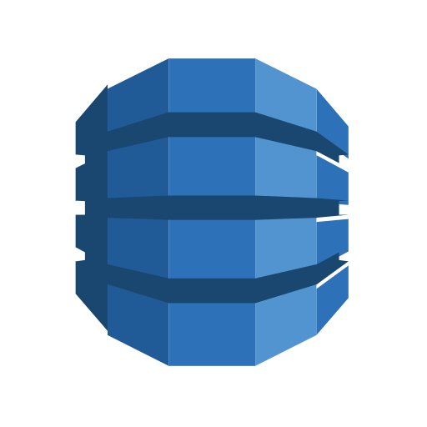
Amazon Database
Amazon DynamoDB
Notes:
DynamoDB is a fast and flexible NoSQL database service for all applications that need consistent, single-digit millisecond latency at any scale.
With DynamoDB, we transition from relational databases to non-relational databases. Let’s look at the differences:
A relational database (RDB) works with structured data organized by tables, records and columns. RDBs establish a well-defined relationship between database tables. RDBs use Structured Query Language (SQL), which is a standard user application that provides an easy programming interface for database interaction. Relational databases do not scale out well horizontally, have problems working with semi-structured data, and normalized data require lots of joins.
A non-relational database is any database that does not follow the relational model provided by traditional relational database management systems. Non-relational databases have grown in popularity because they were designed to overcome the limitations of relational databases in dealing with the demands of big data. Non-relational databases scale out horizontally and work with unstructured and semi-structured data.
Let’s take a look at what DynamoDB has to offer.
27

Slide 28

What is Amazon DynamoDB?
NoSQL database tables
Virtually unlimited storage
Items may have differing attributes
Low-latency queries
Scalable read/write throughput
Notes:
DynamoDB is a fully managed NoSQL database service. Amazon manages all of the underlying data infrastructure for this service and redundantly stores data across multiple facilities within a native US region as part of the fault-tolerant architecture. With DynamoDB, you can create tables and items. You can add items to a table. The surface automatically partitions your data and has table storage to meet the workload requirements. There is no practical limit on the number of items you can store in a table. For instance, some customers have production tables that contain billions of items.
One of the benefits of a NoSQL database is that items in the same table may have different attributes. This gives you the flexibility to add attributes as your application evolves. You can have newer format items stored side by side with older format items in the same table without needing to perform schema migrations.
As your application becomes more popular and as users continue to interact with it, your storage can grow with your application's needs. All of the data in DynamoDB is stored on solid-state drives and its simple query language allows for consistent low-latency query performance. In addition to scaling storage, DynamoDB also allows you to provision the amount of read or write throughput you need for your table. As the number of application users grow, DynamoDB tables can be scaled to handle the increased numbers of read and write requests with manual provisioning. Alternatively, you can enable automatic scaling so that DynamoDB monitors the load on the table and automatically increases or decreases the provision throughput.
Some additional key differentiating features include global tables that enable you to automatically replicate across your choice of AWS regions, encryption at rest, and item Time-to-Live (TTL).
28

Slide 29
Amazon DynamoDB Core Components
Tables, items, and attributes are the core DynamoDB components
DynamoDB supports two different kinds of primary keys: Partition Key and Partition and Sort Key
Notes:
Tables, items, and attributes are the core DynamoDB components.
A table is a collection of data.
Items are a group of attributes that is uniquely identifiable among all of the other items.
Attributes are a fundamental data element, something that does not need to be broken down any further.
DynamoDB supports two different kinds of primary keys.
The partition key is a simple primary key, composed of one attribute called the partition key.
The Partition Key and Sort Key are also known as the composite primary key which is composed of two attributes.
For more information on how DynamoDB works, select the link.
https://docs.aws.amazon.com/amazondynamodb/latest/developerguide/HowItWorks.CoreComponents.html#HowItWorks.CoreComponents.TablesItemsAttributes
29

Slide 30
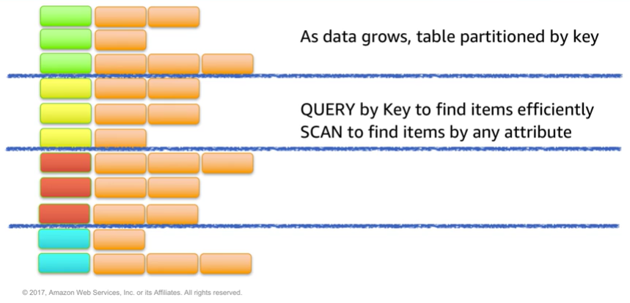
Partitioning
Notes:
As data grows, table data is partitioned and indexed by primary key.
There are two different ways of retrieving data from a DynamoDB table.
In the first method, query operation takes advantage of the partitioning to effectively locate items by using the primary key.
The second method is via a scan, which will allow you to locate items in the table by matching conditions on non-key attributes. The second method gives you flexibility to locate items by other attributes. However, the operation is less efficient, as DynamoDB will scan through all the items in the table to find the ones that match your criteria.

Slide 31
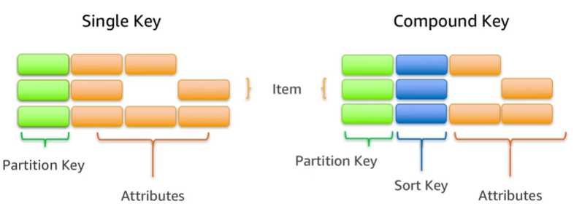
Items in a Table Must Have a Key
Notes:
To take full advantage of query operations and Dynamo DB, it's important to think about the key you used to uniquely identify items in the DynamoDB table. You can set up a simple primary key based on a single attribute of the data values with a uniform distribution, such as the Globally Unique Identifier (GUID) or other random identifiers.
For example, if you were to model a table with products, you could use some attributes, such as the product ID. Alternatively, you can specify a compound key, which will be composed of a partition key and a secondary key. In this example, if I was to have a table with books, I might use the combination of author and title to uniquely identify table items. This could be useful if you expect to frequently look at books by author, since then you could use query.

Slide 32
DynamoDB Overview
Runs exclusively on Solid State Drives (SSDs).
Supports document and key-value store models.
The Global Tables feature replicates your DynamoDB tables automatically across your choice of AWS Regions.
Ideal for mobile, web, gaming, ad tech, and IoT applications.
Accessible via the console, the CLI, and simple API calls.
Notes:
DynamoDB runs exclusively on Solid State Drives, and supports document and key-value store models. The Global Tables feature replicates your DynamoDB tables automatically across your choice of AWS Regions.
Dynamo DB is ideal for mobile, web, gaming, ad tech, and Internet of Things applications.
It’s accessible via the console, the CLI, and simple API calls.
The ability to scale your tables in terms of both storage and provision throughput makes DynamoDB a good fit for structured data from the web, mobile, and IoT applications. For instance, you may have a large number of clients continuously generating data and making large numbers of requests per second. In this case, the throughput scaling of DynamoDB allows consistent performance for your clients. DynamoDB is also used in latency-sensitive applications. The predictable query performance, even in large tables, makes it useful for cases where variable latency could cause significant impact to the user experience or to business goals such as ad tech or gaming.
The DynamoDB Global Tables feature eliminates the difficult work of replicating data between regions and resolving update conflicts. It replicates your DynamoDB tables automatically across your choice of AWS Regions. Global Tables can help applications stay available and performant for business continuity.
32

Slide 33
In Review
DynamoDB is a fully managed NoSQL database service.
Consistent, single-digit millisecond latency at any scale.
No table size or throughput limits.
Global Tables eliminate the difficulty of replicating data between regions and resolving update conflicts.
Notes:
In summary, DynamoDB is a fully managed NoSQL database service. It features consistent, single-digit millisecond latency at any scale, there are no table size or throughput limits, and global tables eliminate the difficulty of replicating data between regions and resolving update conflicts.
It’s a great solution for a database that must have a high performance, but does not require complex operations on the data to make use of it. If you're running simple GET/PUT requests on your data, consider using DynamoDB instead of a relational database.
33

Slide 34
Amazon DynamoDB Demo
Notes:
Please review the DynamoDB demonstration: Amazon DynamoDB Console Demo.
This video demonstration can be found in the learning management system.
34

Slide 35
Part 3: Database Services: Amazon Redshift
Notes:
Introducing Amazon Redshift, an Amazon database service.
35

Slide 36
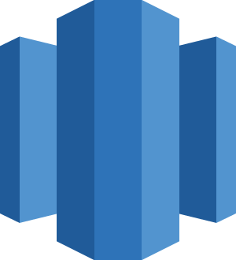
Amazon Redshift
Amazon Redshift
Notes:
Amazon Redshift is a fast, fully managed data warehouse that makes it simple and cost-effective to analyze all your data using standard SQL and your existing Business Intelligence (BI) tools. Let’s take a look at Amazon Redshift and its use for analytic applications.
36

Slide 37
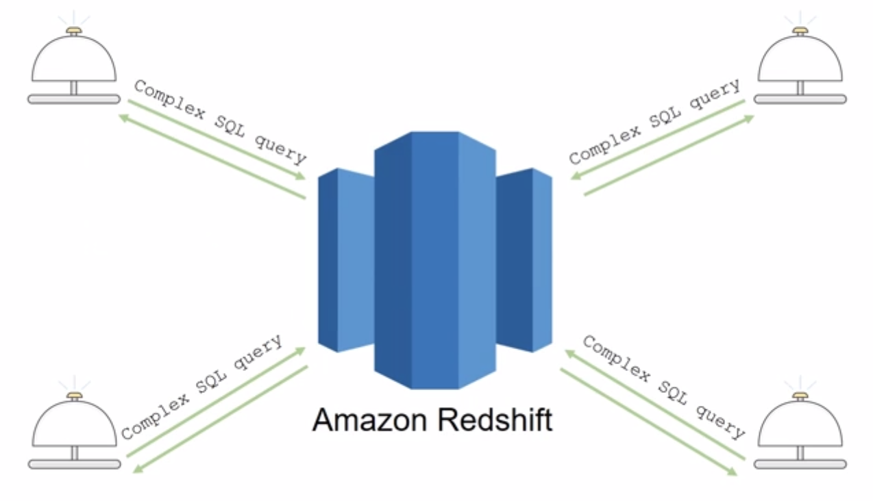
Introduction to Amazon Redshift
Notes:
Analytics are important for businesses today, but building a data warehouse is complex and expensive. Most data warehouses take months to set up and can cost millions of dollars in software and hardware costs—and that’s only the set-up cost.
Amazon Redshift is a fast and powerful, fully-managed data warehouse that makes it simple and cost effective to set up, use, and scale. It allows you to run complex analytic queries against petabytes of structured data using sophisticated query optimization, columnar storage on high performance local disks, and massively parallel query execution. Most results come back in seconds.
Now, let’s review a slightly more detailed exploration of key Amazon Redshift features and some common use cases.
37

Slide 38
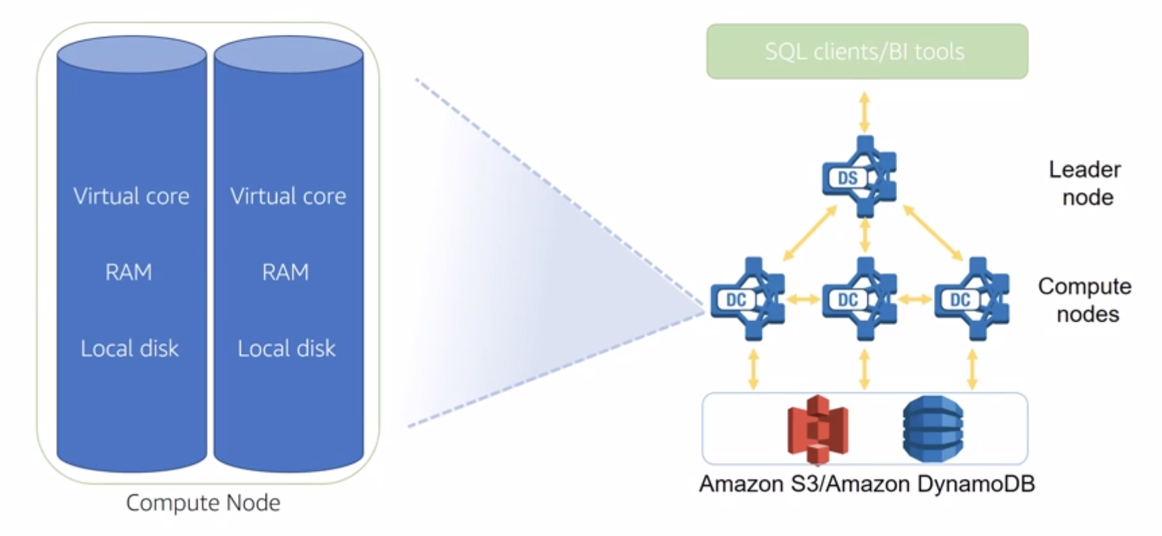
Parallel Processing Architecture
Notes:
The leader node manages communications with client programs and all communication with compute nodes. It parses and develops execution plans to carry out database operations, in particular the series of steps necessary to obtain results for complex queries. The leader node compiles code for individual elements of the execution plan and assigns the code to individual compute nodes. The compute nodes execute the compiled code and send intermediate results back to the leader node for final aggregation.
As is true with nearly all AWS services, you only pay for what you use. You can get started for as little as 25 cents per hour and, at scale, Amazon Redshift delivers storage and processing for approximately $1,000 dollars per terabyte per year. That’s about 1/10 the cost of traditional data warehouse solutions.
The Amazon Redshift Spectrum feature enables you to run queries against exabytes of data directly in Amazon S3.
38

Slide 39
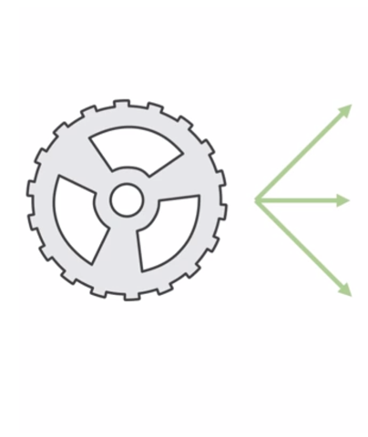
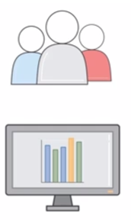
Automation and Scaling
Manage
Monitor
Scale
Notes:
It is quite simple to automate most of the common administrative tasks to manage, monitor, and scale your Amazon Redshift cluster, freeing you up to focus on your data and business.
Scalability is intrinsic in Amazon Redshift. Your cluster can be scaled up and down as your needs changes with just a few clicks in the console.
As always at Amazon Web Services, security is our most important consideration. With Amazon Redshift, security is built-in, providing strong encryption of your data both at rest and in transit.
39

Slide 40
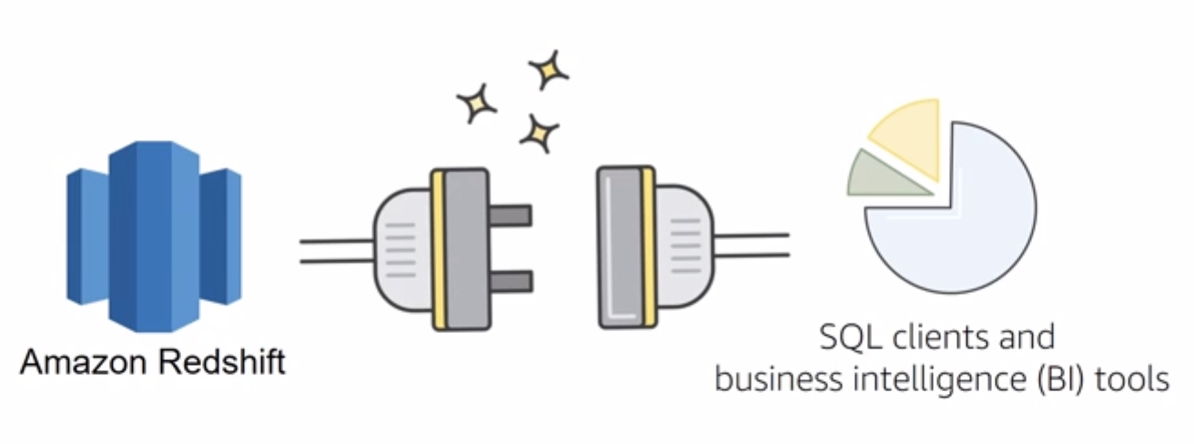
Compatibility
Notes:
Finally, Amazon Redshift is already compatible with the tools you already know and use. Amazon Redshift supports standard SQL and provides high-performance JDBC and ODBC connectors, which allows you to use the SQL clients and BI tools of your choice.
Let’s turn our attention to some common Amazon Redshift use cases.
40

Slide 41

Amazon Redshift Use Cases
Enterprise Data Warehouse (EDW)
Migrate at a pace that customers are comfortable with
Experiment without large upfront cost or commitment
Respond faster to business needs
Big Data
Low price point for small customers
Managed service for ease of deployment and maintenance
Focus more on data and less on database management
Notes:
Now, let’s review a few Amazon Redshift use cases.
Many customers migrate their traditional enterprise data warehouses to Amazon Redshift with the primary goal of agility. Customers can start at whatever scale they want and experiment with their data without having to rely on complicated processes with their IT departments to procure and prepare their software.
Big data customers have one thing in common: massive amounts of data that stretch their existing systems to a breaking point. Smaller customers typically don’t have the money to purchase the amount of hardware and expertise to run these systems. With Amazon Redshift, they can get up and running quickly with their data warehouse at a comparatively low price point.
As a managed service, Amazon Redshift takes care of many of the deployment and ongoing maintenance tasks that often require a database administrator. This frees them up to focus on querying and analysis of their data.
41

Slide 42

Amazon Redshift Use Cases
Software as a Service (SaaS)
Scale the data warehouse capacity as demand grows
Add analytic functionality to applications
Reduce hardware and software costs by an order of magnitude
Notes:
Software as a Service customers are drawn to the scalable, easy-to-manage platform provided by Amazon Redshift. Some use the platform to provide analytic capabilities to their applications. Some deploy a cluster per customer and use tagging to help simplify and manage their service level agreements and billing. Redshift allows you to reduce hardware and software costs exponentially.
42

Slide 43
In Review
Fast, fully managed data warehouse service
Easily scaled with no downtime
Columnar storage and parallel processing architectures
Automatically and continuously monitors cluster
Encryption is built in
Notes:
In summary, Amazon Redshift is a fast, fully managed data warehouse service. As a business grows, you can easily scale with no down time by just adding more nodes. Amazon Redshift automatically adds the nodes to your cluster and redistributes the data for maximum performance.
Amazon Redshift uses columnar storage and a massively parallel processing architecture to parallelize and distribute data and queries across multiple nodes to consistently deliver high performance. It also automatically monitors your cluster and backs up your data so you can easily restore if needed. Encryption is built in – you just have to turn it on.
For more information about Amazon Redshift select the link.
https://aws.amazon.com/redshift/.
43

Slide 44
Part 4: Database Services: Amazon Aurora
Notes:
Introducing Part 2: Database Services Amazon Aurora.
44

Slide 45
Amazon Aurora
Amazon Aurora
Notes:
Amazon Aurora is a MySQL- and PostgreSQL-compatible relational database built for the cloud. It combines the performance and availability of high-end commercial databases with the simplicity and cost-effectiveness of open-source databases.
45

Slide 46
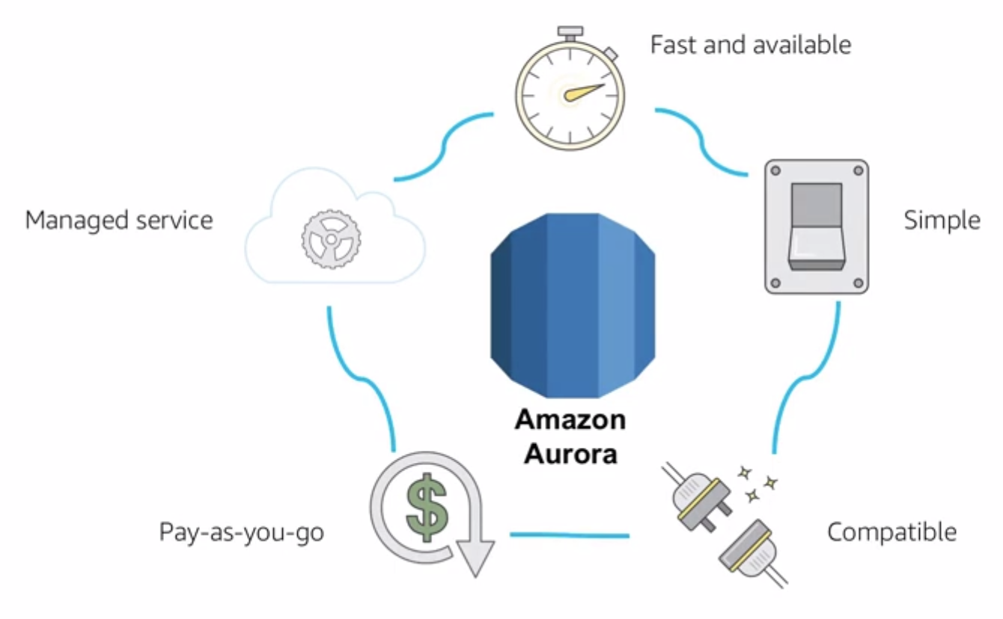
Amazon Aurora Service Benefits
Notes:
First, let’s talk about some of the benefits of Amazon Aurora. It is highly available and offers approximately 5 times the performance of MySQL. Amazon Aurora is simple to set up and uses SQL queries. It has drop-in compatibility with MySQL 5.6 using the Inno DB storage engine.
Amazon Aurora is a pay-as-you-go service, which ensures that you only pay for the services and features you use. It’s a managed service that integrates with features such as the database migration service and the schema conversion tool, which can help you move your data set into Amazon Aurora seamlessly.
46

Slide 47
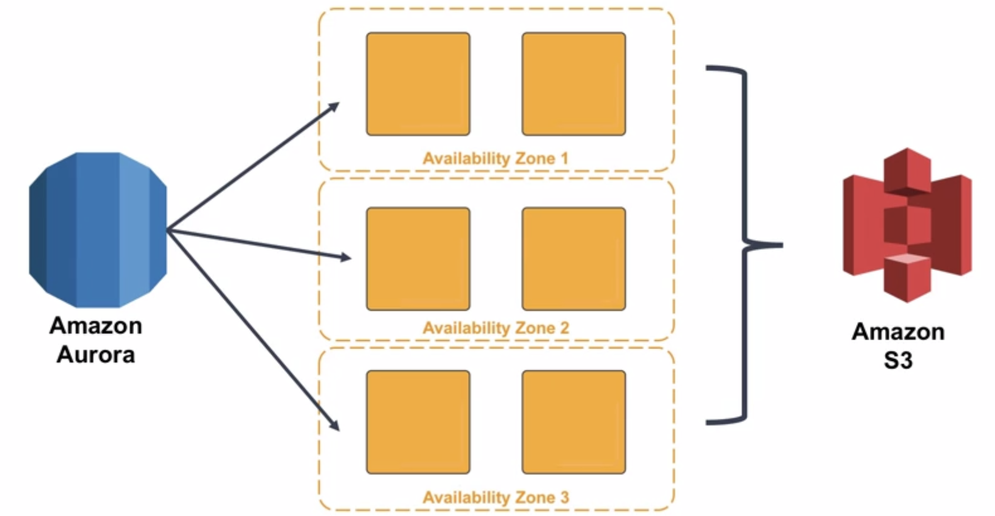
High Availability
Notes:
Why would you use Amazon Aurora over, for example, SQL with Amazon RDS? Most of that decision has to do with the high availability and resilient design that Amazon Aurora offers.
Amazon Aurora is highly available, storing six copies of your data across three Availability Zones with continuous backups to Amazon S3. Up to 15 read replicas can be used to help you ensure that your data is not lost. Additionally, Amazon Aurora is designed for instant crash recovery in the event that your primary database becomes unhealthy.
47

Slide 48
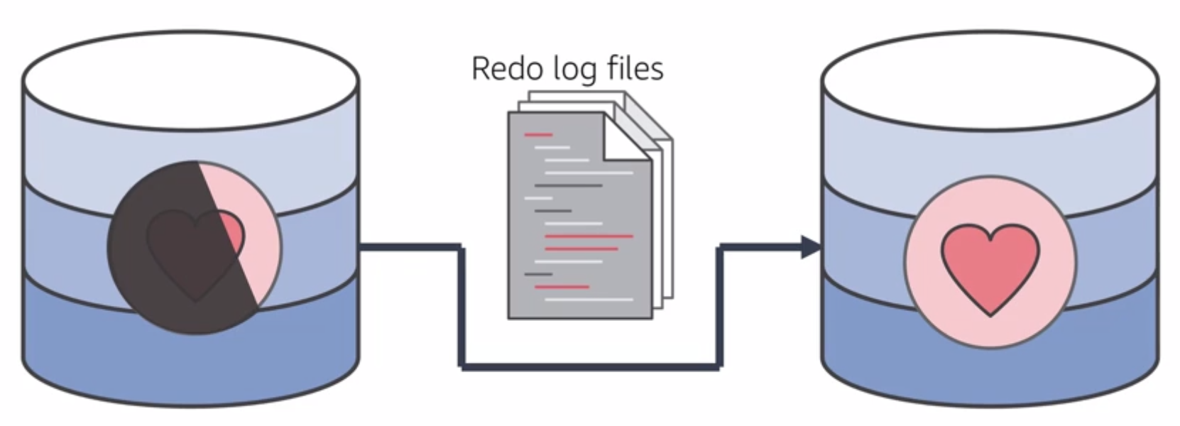
Resilient Design
Notes:
Unlike other databases, after a database crash, Amazon Aurora does not need to replay the redo log from the last database checkpoint. Instead, it performs this on every read operation. This reduces the restart time after a database crash to less than 60 seconds in most cases.
Amazon Aurora has moved the buffer cache out of the database process and makes it available immediately at restart time. This prevents you from having to throttle access until the cache is repopulated to avoid brownouts.
48

Slide 49
In Review
High performance and scalability
High availability and durability
Multiple levels of security
Compatible with MySQL and PostgreSQL
Fully managed
Notes:
In summary, Amazon Aurora is a highly available, performant, and cost-effective managed relational database.
Amazon Aurora provides 5X the throughput of standard MySQL and 3X the throughput of standard PostgreSQL running on the same hardware. This performance is on par with commercial databases, at 1/10th the cost.
It also offers greater than 99.99% availability. It has fault-tolerant and self-healing storage built for the cloud that replicates six copies of your data across three Availability Zones while it continuously backs up your data to Amazon S3.
Multiple levels of security are available, including network isolation using Amazon VPC, encryption at rest using keys you create and control through AWS Key Management Service (KMS), and encryption of data in transit using SSL.
The Amazon Aurora database engine is fully compatible with existing MySQL and PostgreSQL open source databases, and adds compatibility for new releases regularly.
Finally, Amazon Aurora is fully managed by Amazon RDS. You no longer need to worry about database management tasks such as hardware provisioning, software patching, setup, configuration, or backups.
For more information about Amazon Aurora, select the link.
https://aws.amazon.com/rds/aurora/.
49

Slide 50

Module 2, Section 4, Lab 4: Build your DB Server and Interact with your DB Using an App
~ 45 minutes
Notes:
Introducing Section 4, Lab 4, where you’ll build your database server and interact with your database using an app.
50

Slide 51
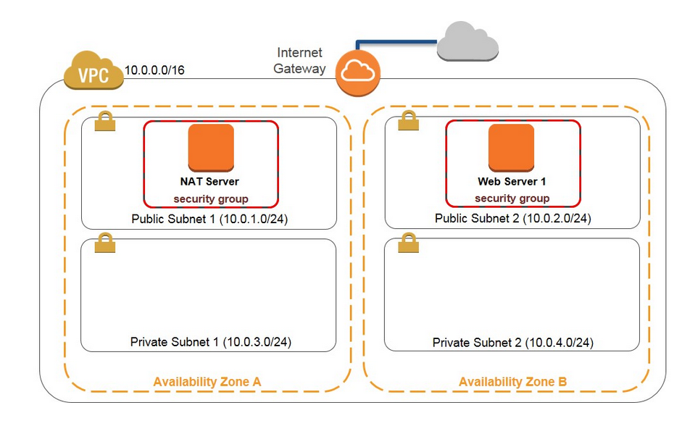
Lab 4 Scenario
This lab is designed to show you how to leverage an AWS-managed database instance for solving relational database need.
Notes:
This lab is designed to show you how to leverage an AWS-managed database instance for solving a relational database need. Amazon RDS makes it easy to set up, operate, and scale a relational database in the cloud. It provides cost-efficient and resizable capacity while managing time-consuming database administration tasks, which allows you to focus on your applications and business. Amazon RDS provides you with six familiar database engines to choose from: Amazon Aurora, Oracle, Microsoft SQL Server, PostgreSQL, MYSQL, and MariaDB.
Amazon RDS multi-AZ deployments provide enhanced availability and durability for DB instances, making them a natural fit for production database workloads. When you provision a multi-AZ DB instance, Amazon RDS automatically creates a primary DB instance and synchronously replicates the data to a standby instance in a different Availability Zone.
After completing this lab, you will be able to:
Launch an Amazon RDS DB instance with high availability.
Configure the DB instance to permit connections from your web server.
Open a web application and interact with your database.
51

Slide 52
Lab 4: Tasks
Create a VPC Security Group.
Create a DB Subnet Group.
Create an Amazon RDS DB instance and interact with your database.
Security Group
Subnet Group
Amazon RDS
Notes:
Your goal by completing this lab is to:
Create a VPC Security Group.
Create a DB Subnet Group.
Create an Amazon RDS DB instance and interact with your database.
52

Slide 53
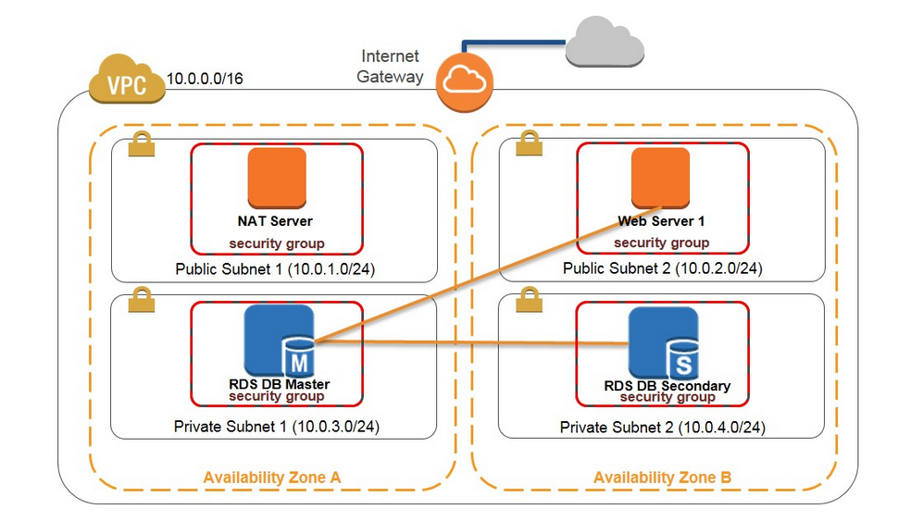
Lab 4: Final Product
~ 45 minutes
~ 45 minutes
Notes:
In this lab, you:
Launched an Amazon RDS DB instance with high availability.
Configured the DB instance to permit connections from your web server.
Opened a web application and interacted with your database.
53

Slide 54

Section 2.04 Review:
Reviewed alternative AWS database offerings and their features
Looked at the differences between managed and unmanaged database solutions
Explored the differences between a SQL and a NoSQL database
Looked at the availability differences of the database services
To finish this module:
Complete:
Knowledge Assessment
Notes:
In summary, we:
Provided an overview of different AWS database services in the cloud and their features.
Revealed the difference between an managed and unmanaged database solutions.
Explored the differences between a SQL and a NoSQL database
Reviewed the availability differences of alternative database solutions.
To finish this module, complete the knowledge assessment.
54

Slide 55
Up Next: Unit 2.05 – AWS Core Services Balancing Scaling Monitoring
Notes:
Now that we have a better understanding some of the compute, storage, networking, and database services offered by AWS, next we are going to take a more in-depth look at balancing, scaling and monitoring.

Slide 56
Thanks for participating!
© 2018 Amazon Web Services, Inc. or its affiliates. All rights reserved. This work may not be reproduced or redistributed, in whole or in part, without prior written permission from Amazon Web Services, Inc. Commercial copying, lending, or selling is prohibited. Corrections or feedback on the course, please email us at: aws-course-feedback@amazon.com. For all other questions, contact us at: https://aws.amazon.com/contact-us/aws-training/. All trademarks are the property of their owners.
Notes:
Thanks for participating.
56

